Slide 1

Performance Review
Team 1
Ben DeSollar – Joslin Some – Adnane Ezouhri

Slide 2



Initial goal
Extension that tracks browsing to fight doom scrolling
Backend server containing all relevant API
Web and mobile that talk to extension monitoring and unblocking browsing with useful tasks to complete
Mobile app on its own preventing doomscrolling

Slide 3
Progress status
Server:
All API completed
Deployed to Heroku
Web:
Basic functionality complete
Deployed to Hostinger
UI/UX fine tuning
Mobile:
Successfully unlocking browsing
Deployment in progress
Extension:
Successfully lock/unlock browsing
UI/UX fine tuning
Setting one instance for entire window,
instead of per tab

Slide 4
Learning experiences
Learning to research feasibility of projects instead of assuming they can be done
Project management experience, working with burndown charts
New tools in addition to our current arsenal

Slide 5
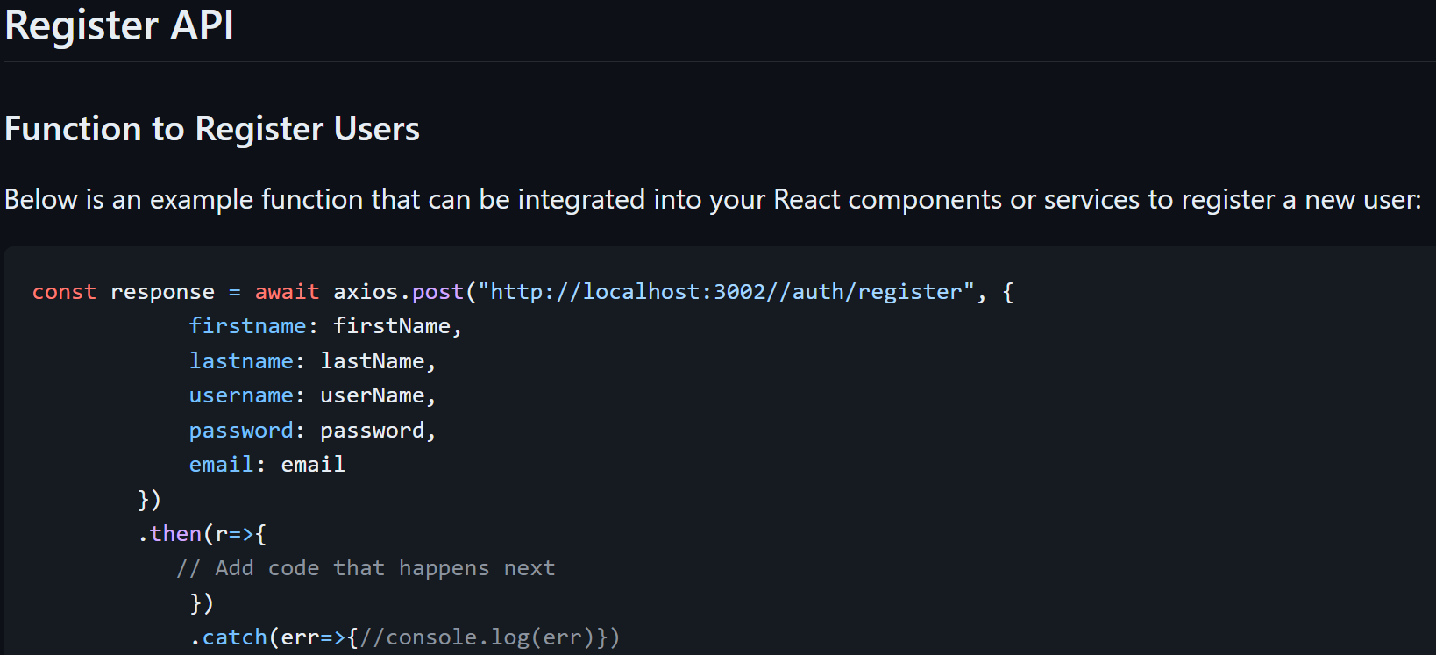
Strengths: Successful teamwork
Team Composition
Adnane: Lead Web Developer
Ben: Lead Mobile Developer
Joslin: Lead Extension Backend Developer and Project Manager
Team Collaboration
Utilized frequent meetings to ensure alignment
Designated "project captains" for coordination
Communication
Emphasized active communication among team members
Encouraged open critique to improve performance
Project Integration
Required effective communication to ensure compatibility between different projects
Ensured seamless integration of web, mobile, and backend components
Documentation
Maintained good developer documentation on a wiki platform
Facilitated understanding and collaboration across the team

Slide 6
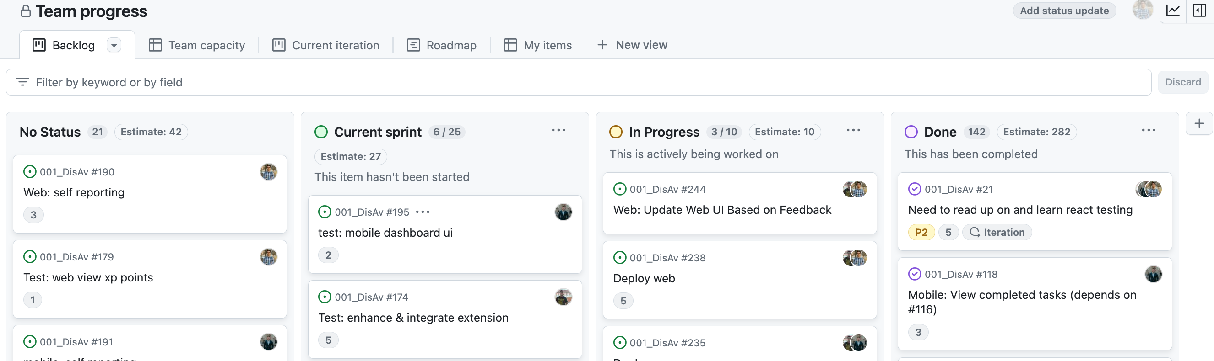
Project management
Split issues to the atomic level, making them more manageable
Though tedious we were very successful with this and made good use of issues and GitHub projects
Made issues for development ideas past our employment, so future company employees can have a solid foundation to work on

